Slide 1
Citizen Seismology and its Contribution to Seismic Risk Reduction: Year 1
R. Bossu and the EMSC Team
European-Mediterranean Seismological Centre
LastQuake:
Mars 2021

Slide 2
Objectives with Fondation SCOR
Improve public info & service reliability
IT infrastructure
Rapidity & accuracy of earthquake information
Widen audiences
Public: Geographically
Scientists: new collaborations
Contribute to risk reduction
Rapid impact assessment (for efficient response)
Improving preparation and awareness among the public

Slide 3
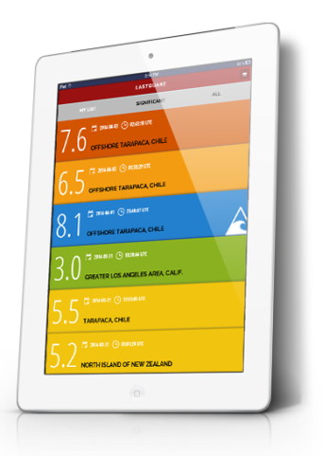
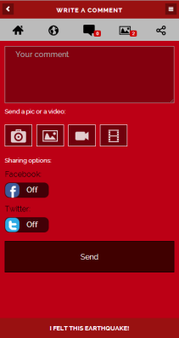
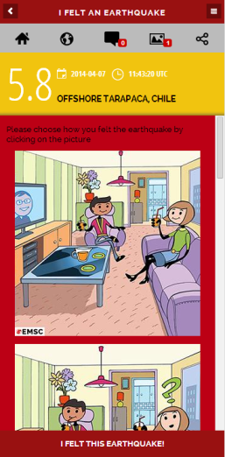
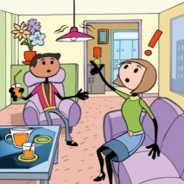
LastQuake App: FELT EQ only!
Questionnaires replaced by cartoons
Best way to collect geolocated pics & videos
Comments shared on Facebook, Twitter
1M+ users worldwide, 40 languages

Slide 4
M6.4 Petrinja, Croatia earthquake, Dec 20 2020
16 013 felt reports
169 geo-located pics
New website:
www.m.emsc.eu

Slide 5
Impact of New Website (Year 1: 762k)

Slide 6
@LastQuake Twitter bot & Direct answers

Slide 7
Fighting misinformation & earthquake prediction

Slide 8
ShakeMaps Collaboration with USGS

Slide 9
Rupture Orientation & Length (coll. ETHZ)

Slide 10
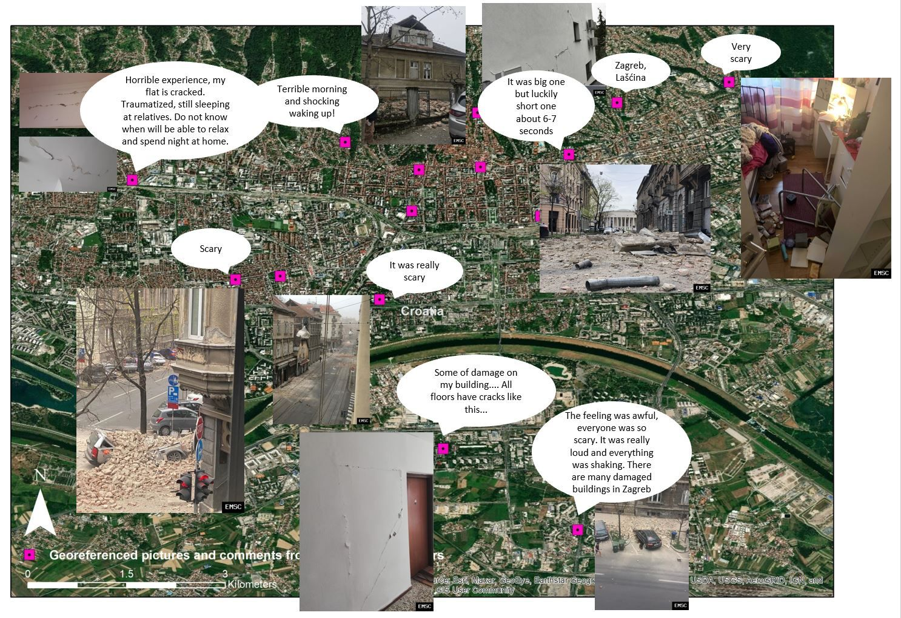
Virtual Survey (colla. with Univ. Newcastle)

Slide 11
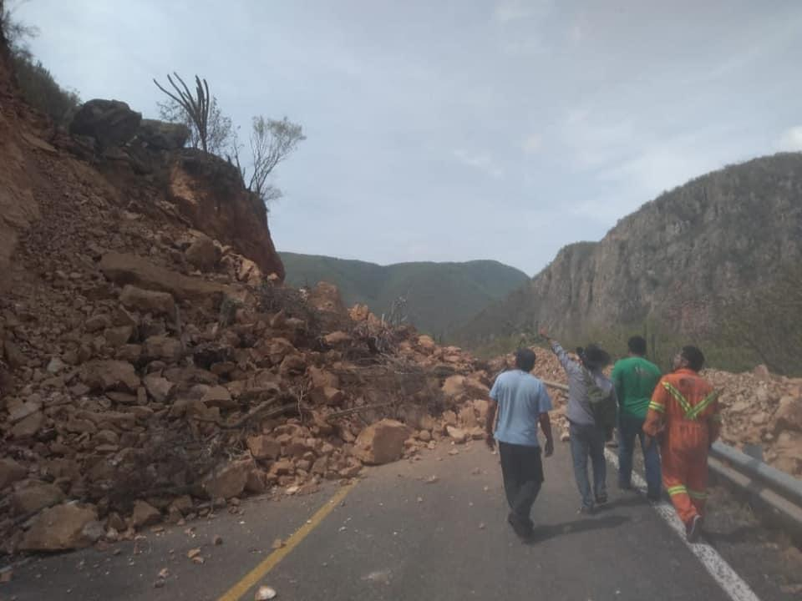
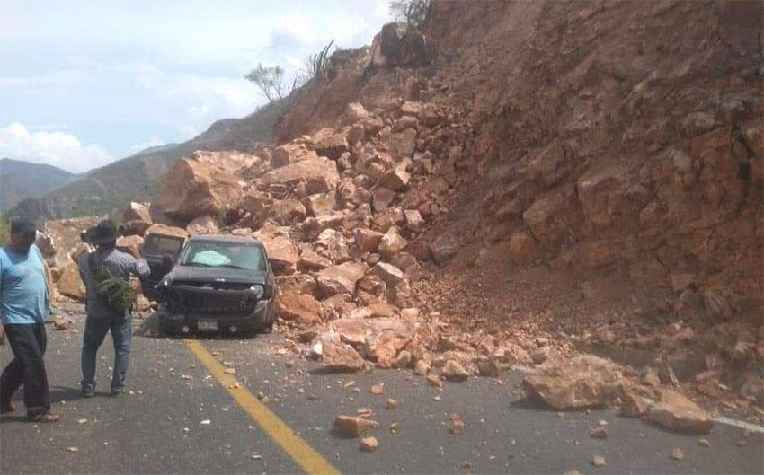
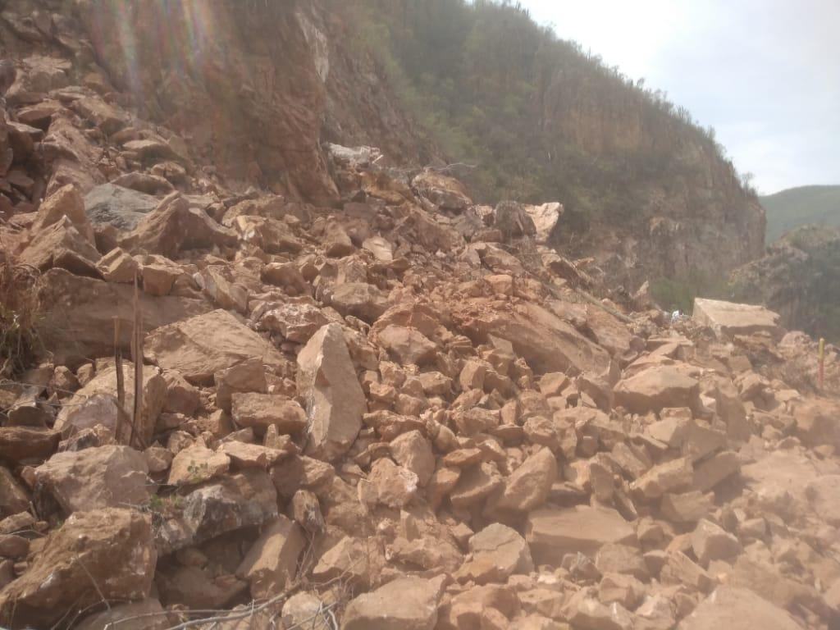
Landslides detection (coll. QCRI)
Harvesting Tweets through keywords
AI for picture identification
480k collected pics, 97k manually checked &
3.7k validated (<1%)!
M 7.4 - OAXACA, MEXICO - 2020-06-23 15:29:04
5h45 after the earthquake

Slide 12
Concluding remarks Year 1
Very productive year 1
Increased user base and new scientific collaborations
A high visibility collaboration (Facebook, Twitter, scientific articles, TV, web and newspaper interviews…)
A big THANK YOU to the SCOR Foundation for an essential support!

